Slide 1


Polyglot Persistence and Big Data
Al.I. Cuza University of Iași
Faculty of Economics and Business Administration
Department of Accounting, Information Systems and Statistics
Graph Databases. Neo4j
By Marin Fotache

Slide 2
Main Resources

Slide 3
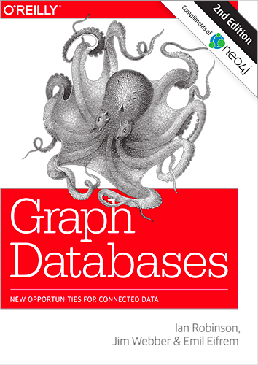
Free e-Book
Ian Robinson, Jim Webber, Emil Eifrem, Graph Databases, O'Reilly, 2015
Freely available at:
http://graphdatabases.com

Slide 4
Another Free (mini) e-Book
Michael Hunger, Ryan Boyd & William Lyon, The Definitive Guide
to Graph Databases
for the RDBMS Developer, Neo Technology, 2016
Freely available at:
https://neo4j.com/whitepapers/rdbms-developers-graph-databases-ebook/

Slide 5
Other Resources
Neo4j website (lots of tutorials, refcards...) https://neo4j.com
Neo4j Cheat Sheet
http://www.neo4j.org/resources/cypher
Cypher Track Start
http://www.neo4j.org/tracks/cypher_track_start
Cypher Query Language Reference, Version 9
https://s3.amazonaws.com/artifacts.opencypher.org/openCypher9.pdf
Non-Free Books
Onofrio Panzarino - Learning Cypher, Packt Publishing, 2014
Rik Van Bruggen – Learning Neo4j, , Packt Publishing, 2014
Dissertation Thesis (2014) – in Romanian – covers some comparison SQL-Cypher (Gârdea Ioana Alexandra)

Slide 6
Video - Tutorials
Intro to Graph Thinking
https://www.youtube.com/watch?v=z3Tvjf0buc8
Intro to Neo4j (2016)
https://www.youtube.com/watch?v=Yzbk6VaavoM
Intro to Neo4j (2016)
https://www.youtube.com/watch?v=U8ZGVx1NmQg
Neo4j Graph Database & Cypher
https://www.youtube.com/watch?v=1kyPUqU-MkE&t=1391s
Ian Robinson: Designing and Building a Graph Database Application (2013)
https://www.youtube.com/watch?v=97vQHT973eo

Slide 7
Video - Tutorials (cont.)
Moving from RDBMS to Graphs (2015)
https://www.youtube.com/watch?v=1mhT8WLgi1g&spfreload=10
Tips and Tricks for Graph Data Modeling 2015
https://www.youtube.com/watch?v=78r0MgH0u0w
05 October 14, 2014 - Intro to Cypher
https://www.youtube.com/watch?v=VdivJqlPzCI&spfreload=10
Neo4j Graph Database & Cypher
https://www.youtube.com/watch?v=1kyPUqU-MkE
Intro to Cypher for the SQL Developer
https://www.youtube.com/watch?v=RIWuA_K7_GY

Slide 8
Basic Concepts of Graph Database

Slide 9
Graphs
Formally: a graph is just a collection of vertices and edges
Pragmatic view: a graph a set of nodes and the relationships that connect them.
DB view: Graphs represent
entities as nodes and
the ways in which those entities relate to the world as relationships.
What can be modeled by graph databases:
Manufacturing
System of roads
Supplychain
Social networks
Etc.

Slide 10
The Labeled Property Graph Model
A labeled property graph is made up of
nodes,
relationships,
properties,
labels.
Nodes
Contain properties
Are documents that store properties as key-value pairs
In Neo4j, the keys are strings and the values are primitive data types, plus arrays of these types
Nodes can be tagged with one or more labels that indicate the roles they play within the dataset
Relationships
Connect nodes
Structure the graph
Always has a direction, a single name, and a start node and an end node
Can also have properties

Slide 11
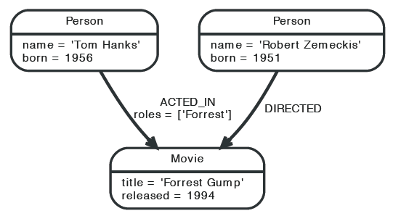
A Basic Graph
Source: The Neo4j Manual, 2015

Slide 12
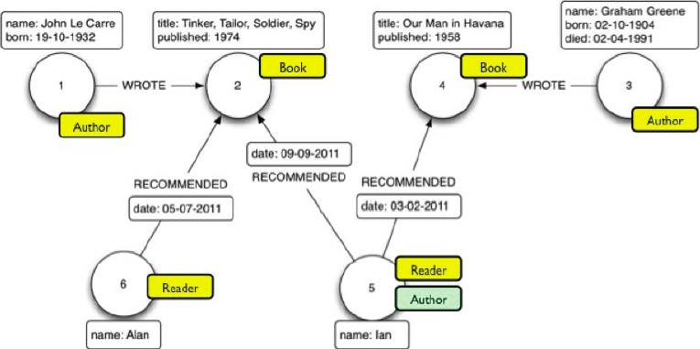
A Labeled Property Graph
Source: Van Bruggen, 2015

Slide 13
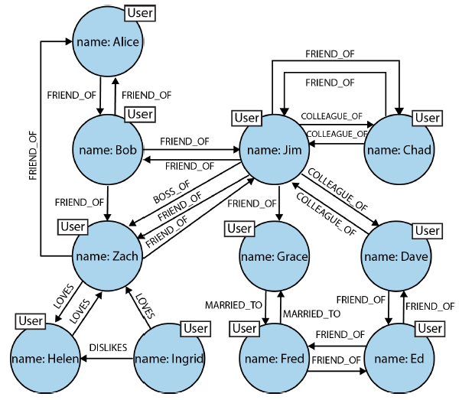
Relatioships in Graph Databases
Source: Robinson, Webber, Eifren 2015

Slide 14
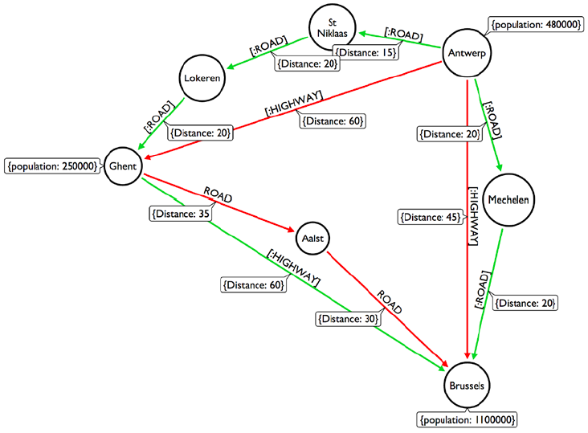
A Route Graph
Source: Van Bruggen, 2015

Slide 15
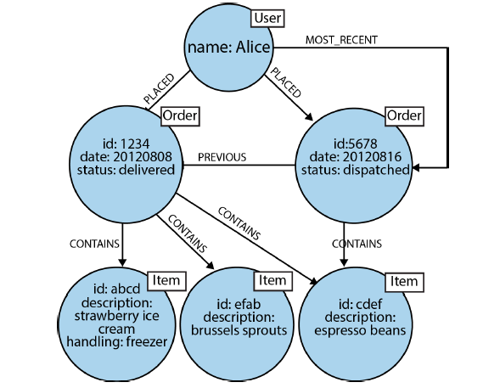
Modeling Order History in a Graph
Source: Robinson, Webber, Eifren 2015

Slide 16
Introduction to Cypher (A high level query language for graph databases)

Slide 17
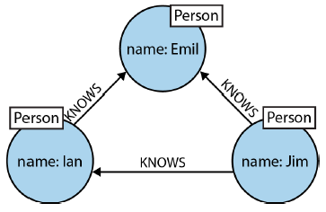

Cypher Fundamentals
Three mutual friends
Nodes represents people (are of type :Person)
emil, jim and ian are nodes identifiers
Each node has one property – name (properties are declared as key-value pairs)
Each pair of nodes is connected through relationships :KNOWS
Source: Robinson, Webber, Eifren 2015

Slide 18
Create Nodes
Create nodes associated with Romania's main regions in a single statement
The name of the region is its identifier
The type (label) of each node is :Region
All nodes have a single property - regionName
CREATE
(Moldova:Region { regionName :'Moldova' }),
(Muntenia:Region { regionName : 'Muntenia' }),
(Transilvania:Region { regionName :
'Transilvania' }),
(Banat:Region { regionName :'Banat' }) ;

Slide 19
Create Nodes (cont.)
Create nodes associated with counties (each is labeled "County")
Counties identifiers are not their names (as with regions), because there are counties – e.g. Satu Mare – having two word names also also there are counties with names identifical to their capitals (Suceava, Vaslui, etc.)
The type (label) of each node is :County
All nodes have a single property – countyName
CREATE
(Iasi_County:County { countyName : 'Iasi' }),
(Vaslui_County:County { countyName : 'Vaslui' }),
(Vrancea:County { countyName : 'Vrancea' }),
(Buzau_County:County { countyName : 'Buzau' }),
(Galati_County:County { countyName : 'Galati' }),
(Braila_County:County { countyName : 'Braila' }),
(Neamt:County { countyName : 'Neamt' }),
(Bacau_County:County { countyName : 'Bacau' }) ;

Slide 20
Create Relationships
Create relationships [:IS_IN_REGION] specifying each county's region
Syntax below is (a bit) closer to SQL
MATCH (c:County),(r:Region)
WHERE c.countyName = 'Iasi' AND
r.regionName = 'Moldova'
CREATE (c)-[rel:IS_IN_REGION]->(r) ;
MATCH (c:County),(r:Region)
WHERE c.countyName = 'Vrancea' AND
r.regionName = 'Moldova'
CREATE (c)-[rel:IS_IN_REGION]->(r) ;
MATCH (c:County),(r:Region)
WHERE c.countyName = 'Buzau' AND
r.regionName = 'Muntenia'
CREATE (c)-[rel:IS_IN_REGION]->(r) ;

Slide 21
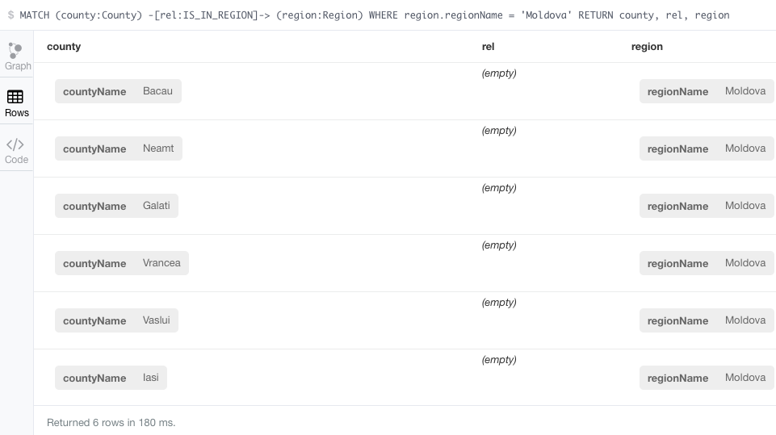
First Cypher Query
Display all the counties in Moldova region – tabular view

Slide 22
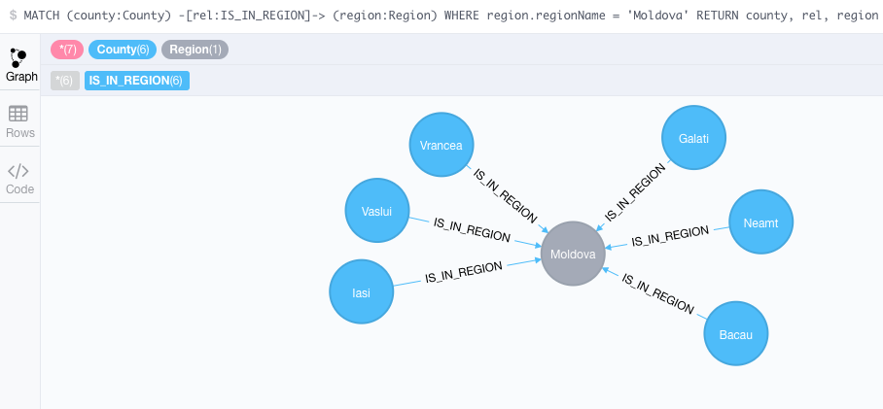
First Cypher Query (cont.)
Display all the counties in Moldova region – graph view

Slide 23
First Cypher Query (cont.)
Three slighly different syntax versions
MATCH (county:County) -[rel:IS_IN_REGION]-> (region:Region)
WHERE region.regionName = 'Moldova'
RETURN county, rel, region
MATCH (county:County) -[rel:IS_IN_REGION]-> (region:Region {regionName : 'Moldova' } )
RETURN county, rel, region
MATCH (county:County) --> (region:Region {regionName : 'Moldova' } )
RETURN county, region

Slide 24
Nodes Associated to Cities
Nodes type (label) is City
All nodes (except Tisita) have two properties – cityName and population
CREATE (Iasi:City { cityName:'Iasi', population: 290422 }) ;
CREATE (Tg_Frumos:City { cityName:'Tirgu Frumos',
population: 9386 }) ;
CREATE (Vaslui:City { cityName:'Vaslui', population: 55407 }) ;
CREATE (Barlad:City { cityName:'Barlad', population: 55837 }) ;
CREATE (Tecuci:City { cityName:'Tecuci', population: 34871 }) ;
CREATE (Tisita:City { cityName:'Tisita'}) ;
CREATE (Focsani:City { cityName:'Focsani', population: 79315 }) ;
CREATE (Rimnicu_Sarat:City { cityName:'Rimnicu Sarat',
population: 33843 }) ;
CREATE (Galati:City { cityName:'Galati', population: 249432 }) ;
CREATE (Braila:City { cityName:'Braila', population: 180302 }) ;
CREATE (Roman:City { cityName:'Roman', population: 50713 }) ;
CREATE (Bacau:City { cityName:'Bacau', population: 144307 }) ;
CREATE (Adjud:City { cityName:'Adjud', population: 16045 }) ;

Slide 25
Relationships Declaring Each City's County
MATCH (city:City),(county:County)
WHERE city.cityName IN ['Iasi', 'Tirgu Frumos'] AND county.countyName = 'Iasi'
CREATE (city)-[rel:IS_IN_COUNTY]->(county) ;
MATCH (city:City),(county:County)
WHERE city.cityName IN ['Vaslui', 'Barlad'] AND county.countyName = 'Vaslui'
CREATE (city)-[rel:IS_IN_COUNTY]->(county) ;
MATCH (city:City),(county:County)
WHERE city.cityName IN ['Tecuci', 'Galati'] AND county.countyName = 'Galati'
CREATE (city)-[rel:IS_IN_COUNTY]->(county) ;

Slide 26
Relationships for Paths Among Cities
Nodes connects through relationships [:CONNECTED_TO]
Relationships have a property – distance
//# Iasi - Vaslui: 71 km
MATCH (from:City) WHERE from.cityName = 'Iasi'
MATCH (to:City) WHERE to.cityName = 'Vaslui'
WITH from, to CREATE (from) -[r:CONNECTED_TO { distance: 71}]-> (to) ;
//# Iasi - Tg.Frumos: 53km
MATCH (from:City) WHERE from.cityName = 'Iasi'
MATCH (to:City) WHERE to.cityName = 'Tirgu Frumos'
WITH from, to CREATE (from) -[r:CONNECTED_TO { distance: 53}]-> (to) ;
//# Tg.Frumos - Roman: 40
MATCH (from:City)
WHERE from.cityName = 'Tirgu Frumos'
MATCH (to:City)
WHERE to.cityName = 'Roman'
CREATE (from) -[r:CONNECTED_TO { distance: 40}]-> (to);

Slide 27
Queries for Displaying Basic Information
Display the labels (types) of nodes in the database
MATCH (n)
RETURN DISTINCT labels(n)
Display all the nodes in the database
MATCH (n)
RETURN n, labels(n)
Display all the City nodes (with their properties) ordered by city names
MATCH (n:City)
RETURN n
ORDER BY n.cityName
Get "some" data - see the next slide
MATCH (n) RETURN n LIMIT 100

Slide 28
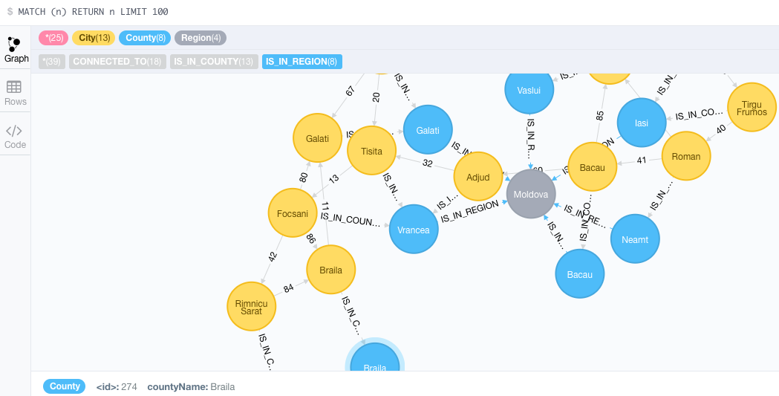
MATCH (n) RETURN n LIMIT 100

Slide 29
Paths of Relationships
Which are the cities in the same county as the city of Adjud ?
Tabular result
MATCH (city1:City) -[relCounty:IS_IN_COUNTY]
->(county:County) <-
[relCounty2:IS_IN_COUNTY]- (city2:City)
WHERE city1.cityName = 'Adjud'
RETURN city2.cityName
Graph result (see next slide)
MATCH (city1:City) -[relCounty:IS_IN_COUNTY]
->(county:County) <-
[relCounty2:IS_IN_COUNTY]- (city2:City)
WHERE city1.cityName = 'Adjud'
RETURN *

Slide 30
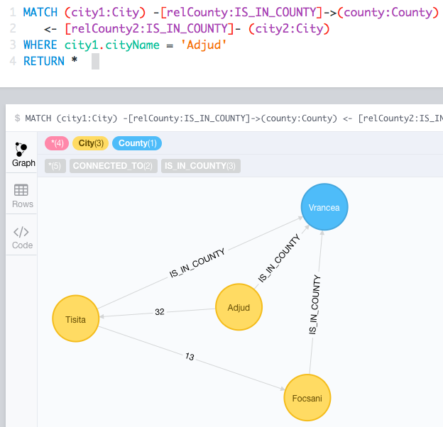
Paths of Relationships (cont.)
Cities in the same county as the city of Adjud - displayed as graph

Slide 31
A Longer Path of Relationships
Which are the cities in the same region as the city of Adjud ? (Graph result)
MATCH
(city1:City)
-[relCounty:IS_IN_COUNTY]->
(county:County)
-[relRegion:IS_IN_REGION]->
(region:Region)
<- [relRegion2:IS_IN_REGION]-
(county2:County)
<- [relCounty2:IS_IN_COUNTY]-
(city2:City)
WHERE city1.cityName = 'Adjud'
RETURN *

Slide 32
Aggregation Queries - COUNT
How many cities are in the "Moldova" region?
MATCH
(city:City)
-[relCounty:IS_IN_COUNTY]->
(county:County)
-[relRegion:IS_IN_REGION]->
(region:Region{ regionName: 'Moldova' })
RETURN count(*)

Slide 33
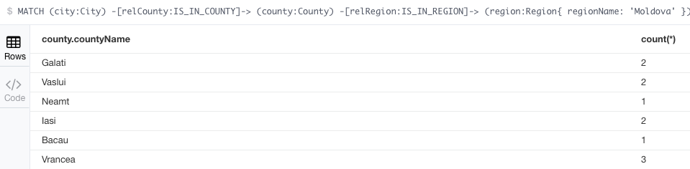
Aggregation Queries – GROUP BY
Display the number of cities in every county of "Moldova" region?
MATCH (city:City)
-[relCounty:IS_IN_COUNTY]-> (county:County)
-[relRegion:IS_IN_REGION]->
(region:Region{ regionName: 'Moldova' })
RETURN county.countyName, count(*)

Slide 34
GROUP BY Two Properties
Display the number of cities in every county of every region (see next slide for results)
MATCH
(city:City)
-[relCounty:IS_IN_COUNTY]->
(county:County)
-[relRegion:IS_IN_REGION]->
(region:Region)
RETURN region.regionName, county.countyName, count(*)
ORDER BY region.regionName, county.countyName

Slide 35
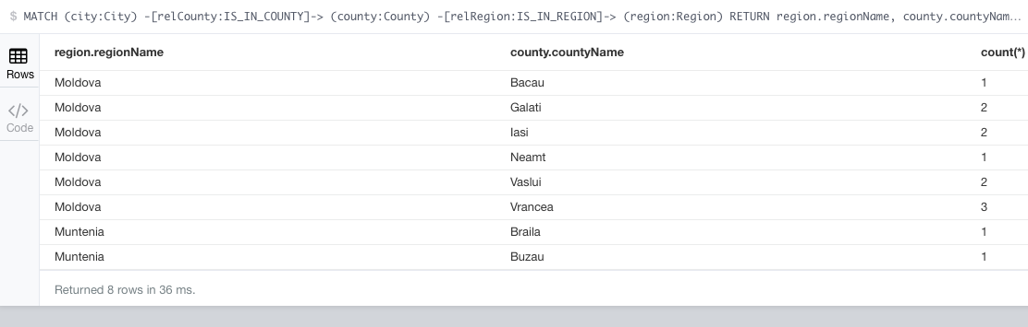
GROUP BY Two Properties (result)
Display the number of cities in every county of every region

Slide 36
GROUP BY and HAVING
Display the counties with more than one city in the database (see next slide for results)
MATCH
(city:City)
-[relCounty:IS_IN_COUNTY]->
(county:County)
WITH county.countyName AS countyName, count(*) AS n_of_cities
WHERE n_of_cities > 1
RETURN *

Slide 37
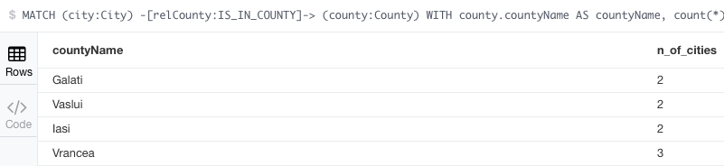
GROUP BY and HAVING (results)
Display the counties with more than one city in the database

Slide 38
Rankings
Display the county with the greatest number of cities
Query below displays just one county. In case there are two or more counties with the same maximum number of cities, there is no one-query solution for displaying all those counties
MATCH
(city:City)
-[relCounty:IS_IN_COUNTY]->
(county:County)
RETURN county.countyName, count(*)
ORDER BY count(*) DESC LIMIT 1

Slide 39
Graphs & Paths in Cypher

Slide 40
Paths in Cypher
As expected, this the area where graph databases/Neo4j excels
Number of nodes a path pass throug is qualified by:
A number, e.g. [rel:CONNECTED_TO*2]
A pair of numbers, e.g. [rel:CONNECTED_TO*0..2]
Functions for paths:
...
..
...

Slide 41
First-Order Neighbours
Display the neighbor cities of Iasi, including the anchor (path departure node - Iasi)
These are first order neighbours
MATCH
(n:City { cityName: 'Iasi' })
-[:CONNECTED_TO*0..1]-
(neighborhood)
RETURN neighborhood
For result – see next slide

Slide 42
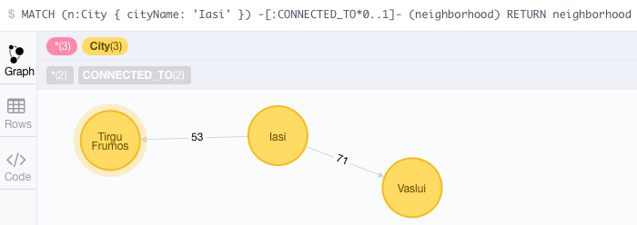
First-Order Neighbours (result)

Slide 43
Filtering the Path Nodes
Display the neighbor cities of Iasi (first order neighbours) with more than 30000 inhabitants
Filter applies to a node property
MATCH
(n:City { cityName: 'Iasi' })
-[:CONNECTED_TO*1]-
(neighborhood)
WHERE neighborhood.population >= 30000
RETURN neighborhood

Slide 44
Filtering the Path Relationships
Display the neighbor cities of Iasi (first order neighbors) found at exactly 53 km from Iasi
Filter applied to relationships - equality operator
MATCH
(n:City { cityName: 'Iasi' })
-[rel:CONNECTED_TO*1{distance:53}]-
(neighborhood)
RETURN *

Slide 45
Trouble With Path Relationship Filter
Display the neighbor cities of Iasi (first order neighbors) within less than 60 kilometers
Filter applied to relationships – greater than operator
MATCH
(n:City { cityName: 'Iasi' })
-[rel:CONNECTED_TO*1]-
(neighborhood)
WHERE rel.distance <= 60
RETURN *
Does NOT Work!!! – see a later slide (collections)

Slide 46
Second-Order Neighbours
Display only the neighbours of the neighbours of Iasi
These are second order neighbours
MATCH
(n:City { cityName: 'Iasi' })
-[:CONNECTED_TO*0..1]-
(neighborhood)
RETURN neighborhood
For result – see next slide

Slide 47
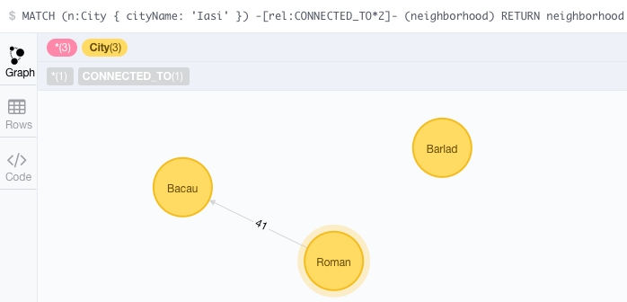
Second-Order Neighbours (result)
The second-order neighbours of Iași

Slide 48
Third- and Fourth-Order Neighbours
Display only the third and fourth order neighbours of Iasi
MATCH
(n:City { cityName: 'Iasi' })
-[rel:CONNECTED_TO*3..4]-
(neighborhood)
RETURN neighborhood
For result – see next slide

Slide 49
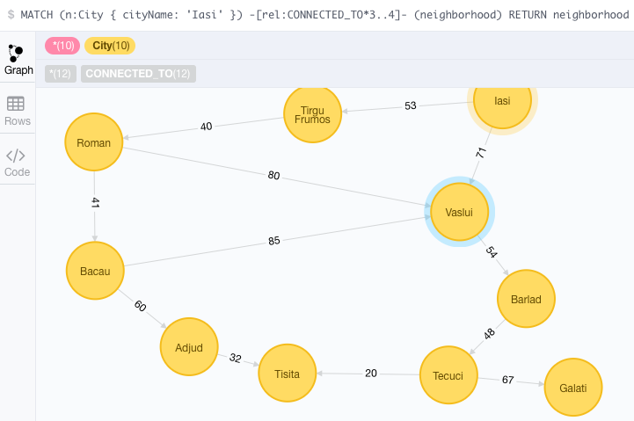
Third- and Fourth-Order Neighbours (result)
Display only the third and fourth order neighbours of Iasi (result)

Slide 50
Remaining Agenda (for Lectures and Labs)
Mini case-study: Querying `Books` database (O. Panzarino)
Mini case-study: Transportation (routes) l
Northwind (import and queries)
http://neo4j.com/developer/guide-importing-data-and-etl/
Case study: DB `Sales`
import data from PostgreSQL/Oracle (creating nodes and relationships)
main query options (Cypher)

Slide 51
Neo4j & R (not covered this year)
RNeo4j package (Nicole White)
https://cran.r-project.org/web/packages/RNeo4j/RNeo4j.pdf
https://github.com/nicolewhite/RNeo4j
https://neo4j.com/developer/r/
Neo4j, Graphs R Cool
https://www.youtube.com/watch?v=bdQ90y9Pefo

